Slide 1
Rural Development Business Center – Servicing & Asset Management Office
Farm Service Agency NACS/NASE National Convention
June 27-28, 2022

Slide 2
Contact Information – Guaranteed Commercial Branch (GCB)
Name | Email | Phone Number | Assignments
Sharon Sachs | sharon.sachs@usda.gov | 314-679-6804 | Branch Chief
GCB FLP Team | Branch email: sm.rd.so.gcb@usda.gov | Main Line 314-457-6402 | ECM Fax: 314-457-4539
Monique Kelly FLP Lead Accountant | monique.kelly@usda.gov | 314-457-4103 | MN, NY, WV
Mattie Bedwell Accountant | madeline.bedwell@usda.gov | 314-457-4036 | AR, CO, IA, LA, OK, OR, TN
Mary Jordan Accounting Technician | mary.jordan@usda.gov | 314-679-6831 | AZ, CA, CT, DE, FL, GA, IL, KS, ME, MD, MA, MT, NE, NH, NM, NV, RI, SC, SD, VT, AK, HI, WP, PR, VI
Barbara Jungenberg Financial Specialist, ECM Contact | barbara.jungenberg@usda.gov | 314-679-6805 | AL, ID, IN, KY, MI, MS, MO, NC, ND, NJ, OH, PA, TX, UT, VA, WA, WI, WY
Notes:
Other Contact info that may be helpful.
* Finance Office - Cash Reporting Division - Collections Branch – PAD agreements for direct loan borrowers
* Branch Chief is Candy Wall
* email: rd.cfo.cb@usda.gov
* Finance Office - Cash Reporting Division - Disbursements Branch – EFT Validations
* Branch Chief is Sharon Maull
* email: rd.cfo.db@usda.gov

Slide 3
GLS Race/Ethnicity/Gender Changes – Guaranteed Commercial Branch
Borrower Race/Ethnicity/Gender Changes - implemented in GLS 2/17/22
A new gender option of “non-binary” was added.
A Guaranteed loan may now be obligated without race/ethnicity/gender information. In those instances, the user will be required to indicate why there is no race/ethnicity/gender data. The options are either that the respective sections of application form were left blank or that the applicant specifically indicated that they did not wish to share the information.
Form FSA-2211 “Application for Guarantee” was revised 3/9/22 to reflect these changes.

Slide 4
GLS Borrower Page: Race/Ethnicity/Gender Changes – Guaranteed Commercial Branch

Slide 5
Unique Entity Identifier (UEI) – Guaranteed Commercial Branch
UEI will be added to the Borrower and Lender screens in GLS.
UEI is not required for FSA, but if you want to enter it, you will need to select from the list. The list is generated based on DUNS, Tax ID and address.
Target Date for implementation is Sept 7th

Slide 6
GLS Reports – Guaranteed Commercial Branch
GLS WebFocus reports
Issue # 1: Excel Format Does not work in Edge or Chrome unless you opt to have the report emailed.
Issue # 2: Frequent Credential Validation Requests
Issue #3: Information not secure notifications
Temporary Solution: In Microsoft Edge: Use the option to “Load in Internet Explorer Mode”. This is done by clicking on the ellipse (3 dots) in the upper righthand corner of the Edge browser. Select ‘Settings” and then “Default Browser”. Then click on the ‘Add’ button and enter https://gls.sc.egov.usda.gov/default.asp to add the GLS site to the list of pages that will automatically open in Internet Explorer mode. Users will need to update the list of sites every 30 days.
Long Term Solution: We are working on a project with the FSA program staff to convert the GLS reports to a new reporting platform, Tableau. The revised Target Date for implementation is March 2023.
Notes:
Internet Explorer was ‘sunset’ on June 15th.

Slide 7
GLS Forms – Guaranteed Commercial Branch
GLS Data-Filled Forms
FSA 2231: Opens in Microsoft Edge-Internet Explorer mode only. See Temporary Solution below.
FSA 2232: Opens in Microsoft Edge, Google Chrome & Firefox (*For Edge, you will need to exit IE mode)
FSA 2235: Opens in Microsoft Edge, Google Chrome & Firefox (*For Edge, you will need to exit IE mode)
FSA 2254: Opens in Microsoft Edge-Internet Explorer mode only. See Temporary Solution below.
Temporary Solution: In Microsoft Edge: Use the option to “Load in Internet Explorer Mode”. This is done by clicking on the ellipse (3 dots) in the upper righthand corner of the Edge browser. Select ‘Settings” and then “Default Browser”. Then click on the ‘Add’ button and enter https://gls.sc.egov.usda.gov/default.asp to add the GLS site to the list of pages that will automatically open in Internet Explorer mode. Users will need to update the list of sites every 30 days
Notes:
Form 2231 - Request for Obligation of Funds – Guaranteed Loans
Form 2232 – Conditional Commitment
Form 2235 – Loan Guarantee
Form 2254 – Guaranteed Loan Report of Loss

Slide 8
Quick Reference Guides – Guaranteed Commercial Branch
The GLS Quick Reference Guides are available at Training (usda.gov) under Training Guides and Software User Guides.
4A-Change in Case Number & Loan Number
4D-Change in Case Number, Name & Address
9G-Change in Borrower Mail Code GLS transactions
Application Authorization Security Management (AASM)
Guaranteed Farm Loan Systems
Guaranteed Loan Debt Offsets
Guaranteed Consolidations
Guaranteed Loan Closings in GLS
Guaranteed Lender PAD in GLS
Guaranteed Loan Restructures in GLS
Guaranteed Transfers & Assumptions in GLS
Guaranteed Loan Borrower Adjustments FSA-2247
EFT for Guaranteed Loans
LINC for Lenders
Level 2 eAuth Accounts
Semi-Annual Status Reports

Slide 9
Reminders – Guaranteed Commercial Branch
Loan Closing
Please be sure to include the correct advance amount when processing a loan closing in GLS. This will help reduce errors on the Status Reports.
The Maturity Date and Period of Advances entered on the Loan Closing should reflect the entire term of the Line-of-Credit.
Loan Restructures
Form FSA-2249 is required any time the lender restructures the loan, even if the lender is just extending the Maturity Date. The lender can also restructure to adjust the interest rates.
Once a Line-of-Credit (LOC) is restructured, the lender can no longer advance additional funds
When submitting Form 2249, please be sure to complete the full form, items 1-13.
Notes:
Loan Closing –
If funds were advanced at closing, but it is not entered on the Closing transaction, it causes an error on the status report because the Unpaid Principal will exceed the Principal Advanced.
On LOC, the Maturity Date should reflect the entire term of loan. They should NOT enter as 1 year term to be renewed each year. What we are seeing is the LOC is set up with a 1-year term to be renewed each year. Then after year 1, we get a 2249 to restructure the loan for another year. Once the loan is restructured, they are no longer allowed to make advances on the loan…..so it defeats the purpose of an LOC.
Assumptions:
When adding the Loan Guarantee Request, the Requested Loan Amount should equal the Principal Amount Assumed (Item 14 on Form-2246). This will become the Loan Amount of the new loan for the Transferee.

Slide 10
Reminders (cont.) – Guaranteed Commercial Branch
Consolidations
The Maturity Date of the new LOC must be the same as the Maturity Date on the oldest LOC involved in the Consolidation.
Capitalization of interest is not allowed for a consolidation.
If the LOCs are secured by real estate, they cannot be consolidated.
Loan Transfers & Assumptions
An Application Package and Approved Loan Guarantee Request must be input into GLS for the Transferee
The Approval Date on the Loan Guarantee Request in GLS must be < or = to the Date of Transfer & Assumption (Item 12 on Form FSA-2246)
Notes:
Assumptions:
When adding the Loan Guarantee Request, the Requested Loan Amount should equal the Principal Amount Assumed (Item 14 on Form-2246). This will become the Loan Amount of the new loan for the Transferee.

Slide 11
Reminders (cont.) – Guaranteed Commercial Branch
Loss Recoveries/Voluntary Payments from the Borrower
Funds should be deposited through NRRS using Collection Code ’33’ for Recoveries, ’80’ for Voluntary collections, or ‘82’ for Debt Settlement payments.
For loans eligible for Offset, no additional forms are required, and nothing has to be input in GLS.
For loans that are NOT subject to Offset, the info must be input into GLS using the ‘Click here to add Loss Claim’ hyperlink on the View Loan screen. Select Loss Type ’04’ for Recoveries, ’13’ for Voluntary Payments, or ’14’ for Compromise Offers. Once the loss is submitted in GLS, Form 2254 should be signed and submitted to GCB for processing. (Only one FSA signature is required on the form.)
Notes:
Guaranteed Loan Collection Codes
30 – Guarantee Fees
31 – Repayment of Appraisal Fee
32 – Payment on Repurchased guaranteed loan
33 – Lender Recovery or Final Loss Refund
34 – (Finance office use only)
35 – Other guaranteed loan remittance
70 – Internal Administrative Offset (IAO) – Other
71 – IAO – DCP
72– IAO –LCP
73– IAO –CRP
74– IAO –EQIP
75– IAO –Tobacco
76– IAO –Peanuts
77– IAO –Rice
78– IAO –LDP/Market Asst Loan
79– IAO –DCC Stay status
80 – Voluntary
81 - DOJ
82 – Debt Settlement
83 - Other
84 – TOP
Loss Types to:
04 – Recovery after Final Loss
13 – Voluntary Payment
14 – Compromise Offer

Slide 12
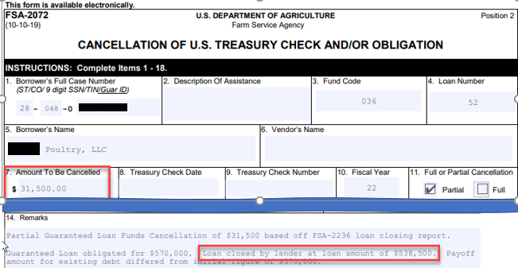
Reminders (cont.) – Guaranteed Commercial Branch
De-obligation Requests
When submitting de-obligation requests, please include the new obligation amount in the comments.

Slide 13
Lender Interactive Network Connection (LINC) – Guaranteed Commercial Branch
The Lender Interactive Network Connection (LINC) allows for electronic reporting by lenders to USDA agencies including FSA.
The USDA LINC Home page is located at https://usdalinc.sc.egov.usda.gov/. Lenders are required to have a level 2 eAuthentication ID and password prior to being authorized in the LINC system.
LINC’s primary electronic reporting functions are:
Submit status reports (semiannual and default)
Add loan closing
View loans
Lender Pre-Authorized Debit (PAD)
To gain access to LINC, Lenders should start on the USDA LINC Home page. For more information, please see the LINC Quick Reference Guide.
Notes:
Encourage Lenders to sign-up for LINC – Cost savings (printing , envelopes, postage). Time savings – input of status reports, PAD allows guarantee fees to be paid electronically so no longer have to deposit through NRRS.

Slide 14
eAuthentication (eAuth) Account Setup– Guaranteed Commercial Branch
Account Creation
Customers must create an eAuthentication ID and complete the level 2 verification process.
Step by step instructions are available in the Quick Reference Guide for Level 2 eAuth Accounts
Identity Verification
Successful Online Identity Verification:
Once the user passes the Online Identity Verification, the eAuth account is ready to get added in AASM for LINC access.
Unsuccessful Online Identity Verification:
After multiple (3) failed attempts, the user must visit an LRA office to verify their identity in person. The user must take one of the following official government-issued photo identifications:
State or Province-issued driver's license or photo identification card from the United States or Canada.
US Military or US Federal Government employment PIV/CAC (Smart) identification card (DoD, DoS, DHS, etc.)
A valid passport issued by any country listed on the U.S. Department of State website.
A list of USDA Service Centers can be found at https://offices.sc.egov.usda.gov/locator/app?type=lra.
Notes:
Prior to gaining access to LINC, each user must create an eAuth ID and complete the level 2 verification.
This QRG can be found on the FSA Intranet site under FLP Software Guides for the Guaranteed Loan System, https://inside.fsa.usda.gov/program-areas/daflp/software-manuals/index, and publicly, in the Guaranteed Loans – Lender Toolkit at https://www.fsa.usda.gov.

Slide 15
Application Authorization Security Management(AASM)– Guaranteed Commercial Branch
Application Authorization Security Management (AASM)
Agency’s AASM Responsibility
Grant LINC access to lender-employees who have level 2 users accounts
Assign, remove, and maintain employee security roles in AASM
Maintain employee information (telephone and fax numbers) in AASM
Lender’s AASM Responsibility
Request administrative access to LINC
Assign, remove and maintain employee security roles in AASM
Maintain employee information (telephone and fax numbers) in AASM
Lender Security Roles in AASM
Lender Administrator: Allows the user to grant lender or branch roles to other users assigned to any of the lender’s branches. Also, allows the user to enter transactions for all of the lender’s branches
Branch Administrator: Allows the user to grant branch roles for only the lender branch for which the user is associated. Also, allows the user to enter transactions for only the lender branch for which the user is associated.
Lender Representative: Allows the user to enter transactions for all of the lender’s branches.
Branch Representative: Allows the user to enter transactions for only the lender branch for which the user is associated.
Quick Reference Guide for Application Authorization Security Management (AASM)
GLS Home Page (usda.gov)
Notes:
The QRG is available at https://inside.fsa.usda.gov/program-areas/daflp/software-manuals/index.

Slide 16
Lender Interactive Network Connection (LINC) – Guaranteed Commercial Branch
FSA LINC Homepage: FSA LINC Home (usda.gov)
Notes:
Users will access the FSA LINC functions after registration and lender role set up in AASM.

Slide 17
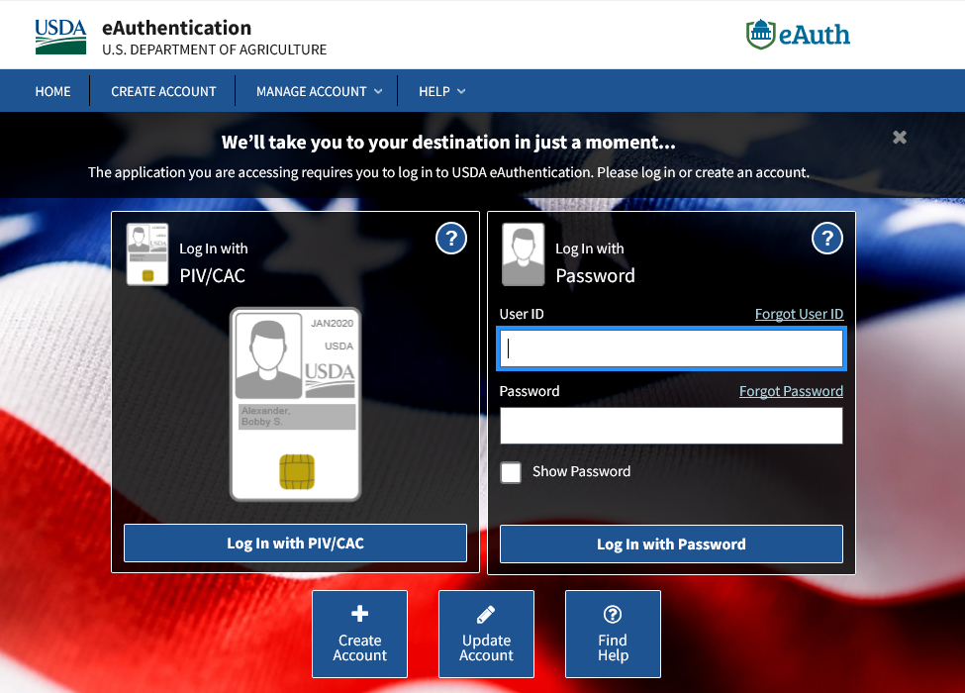
Lender Interactive Network Connection (LINC) cont. – Guaranteed Commercial Branch
eAuthentication Login
Lender will log into LINC with User ID and Password
Notes:
The user will be prompted to enter their eAuthentication User ID and password.

Slide 18
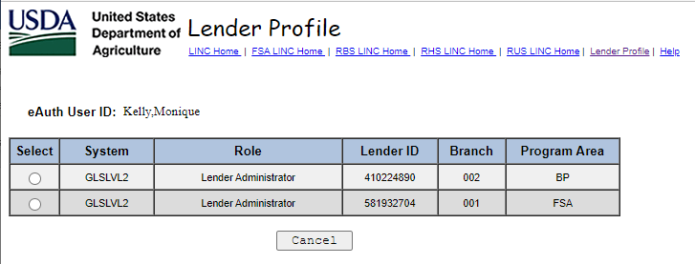
Lender Interactive Network Connection (LINC) cont. – Guaranteed Commercial Branch
Lender Profile
Upon Login, if a lender-employee is associated with more than one Lender ID/branch, then the employee must use the Lender Profile screen to switch between Lender IDs/branches
Notes:
Upon signing in, the user is directed to the Lender Profile page to select the Lender ID to work under. The lender can navigate back to this screen later by selecting the “Lender Profile” tab at the top of screen.

Slide 19
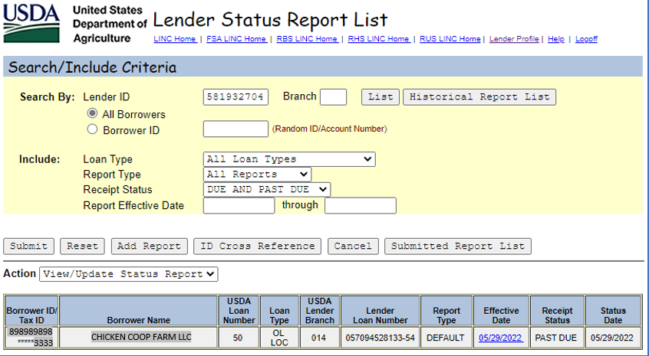
Lender Interactive Network Connection (LINC) cont. – Guaranteed Commercial Branch
Lender Status Report List
Defaulted Search Criteria
Notes:
The user will get a list of Due and Past Due status report. To update the status report, the lender can click on the Effective Date of the status report that needs to be updated. The user can also click the “Add Report” button to add a status report for a loan not shown on the list.

Slide 20
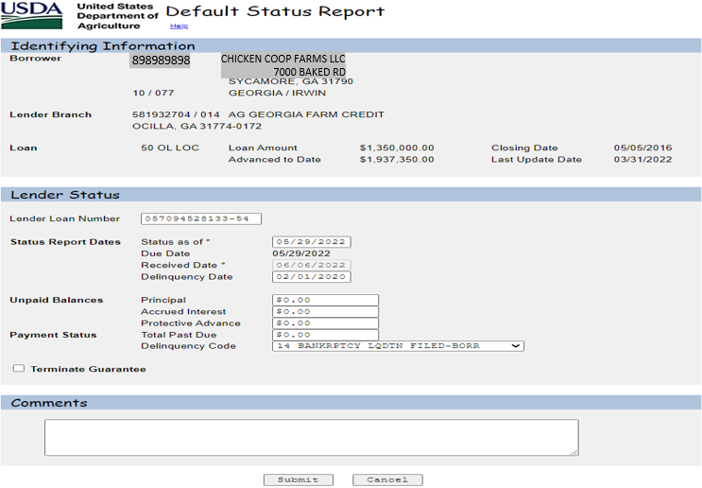
Lender Interactive Network Connection (LINC) cont. – Guaranteed Commercial Branch
Lender Status Report
Notes:
The status report screen mirrors what we all see in GLS, and the submitted status flows directly to GLS and updates the loan.

Slide 21
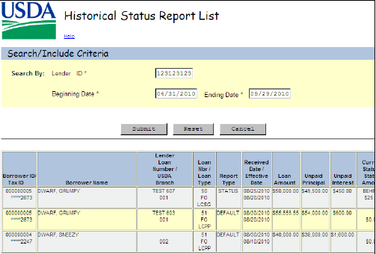
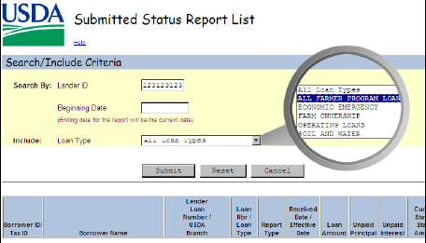
Additional Status Report Features – Guaranteed Commercial Branch
Historical Report List
This search allows the Lender to view a list of all status reports that fall within a specified date range.
Submitted Status Report List
This search allows the Lender to view a list of submitted status reports from a specified date on and by loan type.
Notes:
Historical Report List and Submitted Status Report List buttons are on the Lender Status Report List home screen.
Status reports submitted within the last 60 days can be accessed on the Submitted Status Report List. Reports submitted more than 60 days prior can be viewed on the Historical Status Report List.

Slide 22
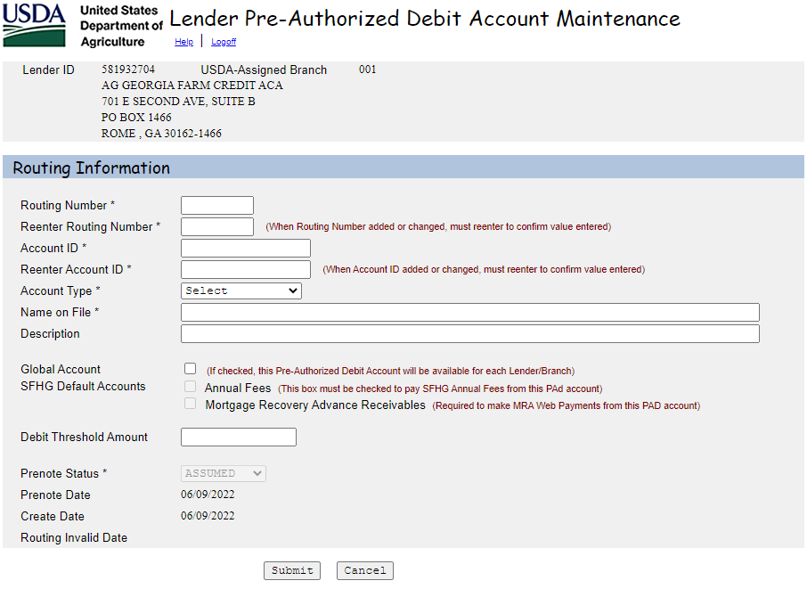
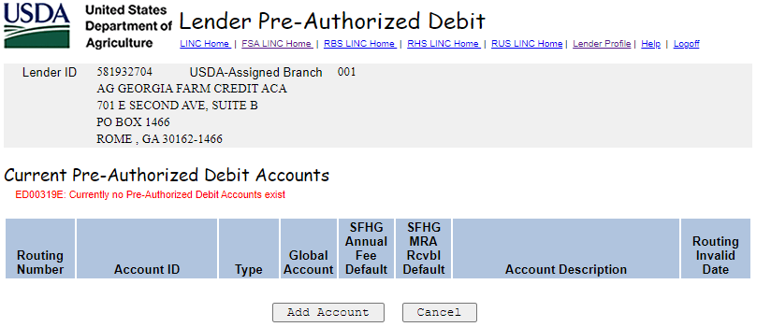
Lender Interactive Network Connection (LINC) cont. – Guaranteed Commercial Branch
Pre-Authorized Debit Account
Lenders can add a PAD Account to be used for Guaranteed Loan Fee Submissions by selecting the Lender PAD Account Maintenance hyperlink at FSA LINC Home (usda.gov).
For more information on how use the PAD Account to process a Guarantee Loan Fee Payment or for information on FSA employees can add a Lender PAD Account in GLS, please see the Quick Reference Guide for Guaranteed Lender PAD in GLS
Notes:
QRG is available on the FSA Intranet site at https://inside.fsa.usda.gov/program-areas/daflp/training-guides/index under GLS Training Materials.
Even if the lender opts out of LINC access, agency employees can set up the lender’s PAD account with permission from the lender.

Slide 23
Lender Interactive Network Connection (LINC) cont. – Guaranteed Commercial Branch
Other LINC Topics
Any Lender Branch with LINC access will not receive paper status reports in the mail. For example, if a user is set up as a Lender Administrator under branch 001, then the lender will not receive paper statuses and should process statuses for all branches electronically on LINC. However, if a lender only has a user set up as a Branch Administrator under branch 3, then the lender will receive hard copy 2241 forms for all other branches no user roles associated.
There are two types of user accounts:
eAuthentication Accounts established post June 24, 2020
Each new eAuthentication account must have a unique email address
Reset Password: New self-service password reset process; email is sent with Reset Password link
Accounts established prior to June 24, 2020
Reset Password: Legacy process using security questions if the account does not have a unique email address. Otherwise, the new self-service password reset process can be used.
Legacy accounts will keep existing user ID
Microsoft Edge is the recommended browser for GLS and LINC. For optimal performance, the Edge browser can be run in Internet Explorer mode.
Notes:
LINC users will get notified of due and past due status reports via the email listed on their eAuth account.
Users will receive the batch emails sent on March 31st and September 30th for statuses due. Also, on May 1st and November 1st, users will receive an email listing the branches that have past due status reports. This email will also mention any branches that have default statuses due.

Slide 24
This Photo by Unknown Author is licensed under CC BY-SA

Slide 25
Servicing Office
Farm Loan Branch Overview

Slide 26
Servicing Office
In December 2020, the National Financial Accounting and Operations Center (NFAOC) was reorganized into two new organizations: The Servicing Office and the Finance Office; both report to the Rural Development Business Center.
Servicing Office mission: Provide loan servicing performance and efficiency for Rural Development (RD) and Farm Service Agency (FSA) programs through exemplary customer service and fiscal stewardship while cultivating a highly productive workforce.
Even though organizationally separate, our functions to support FSA continue to be intertwined; therefore, we will continue to provide exceptional loan servicing and financial services.
RD Business Center
Servicing Office
Finance Office

Slide 27
Overview of the Farm Loan Branch (FLB)
The Farm Service Agency offers loans to help farmers and ranchers get the financing they need to start, expand or maintain a family farm. FLB has a “Service Level Agreement” with the Farm Service Agency to provide servicing and financial reporting functions for the Farm Loan Program portfolio.
The Farm Loan Branch is mainly responsible for planning, organizing, directing, and coordinating loan servicing and management reporting activities related to the development, maintenance, and operation of the detail “accounting systems” for direct loans in the Farm Loan Portfolio.

Slide 28
Overview of the Farm Loan Branch (FLB) – Cont.
Team members process a full range of borrower accounting transactions for all direct loans serviced by the Farm Loan Program portfolio, such as discrepancy processing, consolidations, re-amortizations, refunds and changes in application of payments.
FLB currently processes transactions out of two systems which are the Program Loan Accounting System (PLAS) and Direct Loan System (DLS).

Slide 29
Farm Loan Portfolio Stats as of March 31, 2022
Portfolio | Unpaid Principal Balance | # of loans
FSA | $14,369,915,527 | 144,422

Slide 30
FY22 Outreach Initiatives
Bi-monthly Status updates on servicing requests in the Enterprise Content Management System (ECM) and Automated Discrepancy Processing System (ADPS)cash lines over 30 days old
Smaller Outreach Meetings
Daily Reports of Tech ADPS Processing and ECM completions
Notes:
In Q2 FY22 we have worked on piloting two new key initiatives to help improve the overall customer experience:
Bi-monthly status updates – in February, we began providing the field office bi-monthly updates on servicing requests submitted via ECM and ADPS cash lines over 30 days old.
For servicing requests in ECM, we have seen dramatic improvement with the implementation of this process. Three weeks before implementing this process our late ECM workload was average 88 late servicing requests per week. After the process was implemented, we looked at the three-week average again, and we were now averaging 46 late servicing requests per week which is a 48% drop in the average per week.
For the ADPS cash lines over 30 days old, we have seen a strong improvement with the implementation of this process. We took an average of three weeks prior to the implementation of this task to see what our average was, for those three-weeks we were averaging approximately 1025 cash lines on suspense. After the process was implemented, we looked at the three-week average again, and we were now averaging 801 cash lines sitting out on suspense which is a 22% drop in the average per week.
Smaller Outreach Meetings – [discuss background of process] In Q2, we have shifted from one meeting with 50-100 participants to four section meetings with 10-15 participants with the Farm Loan Chiefs. The week of March 21 we had all four meetings, breaking up the meetings into smaller settings increased the overall participation dramatically. To put the numbers into perspective, in Q1 when we were still having one large meeting with 50-100 participants, we only received three questions from the field during the meeting. For Q2, if you combined all the questions asked at all four meetings, we had fourteen questions which is almost triple the number of questions asked in Q1. Additionally, the conversations at these smaller meetings felt more real and you could tell people were more willing to share their questions/comments. We are continuing to test out this new process throughout FY22 and hopefully we will continue to get the same results thus far.

