Slide 1


www.jm-aq.com
June 29, 2022
National Association of Credit Specialists
National Conference - Legislative Update
Andy Quinn, Managing Partner
McAllister & Quinn
Notes:
Background with image

Slide 2
www.jm-aq.com
Summary
Briefing Overview
FY23 Agriculture Appropriations – Salaries and Expenses
FSA Loan Funding Levels FY23
FSA 2022 Workforce Snapshot
Outlook for 2022
Notes:
Background with image

Slide 3
FY23 Agriculture Appropriations – Salaries and Expenses
www.jm-aq.com
Salaries and Expenses
FY22: $1,175,670,000
FY23: $1,229,396,000 – Increase of $53,726,000 from FY22
No mention in House Appropriations draft bill of funds for hiring and retention.
Notes:
Simple Bullet Point Slide example

Slide 4
FSA Loan Funding Levels FY23
www.jm-aq.com
Item | 2022 Enacted | 2023 Appropriations¹
Guaranteed Farm Ownership Loans | $3,500,000,000 | $3,500,000,000
Direct Farm Ownership Loans | $2,800,000,000 | $3,100,000,000
Unsubsidized Guaranteed Operating Loans | $2,118,482,000 | $2,118,491,000
Direct Operating Loans | $1,633,000,000 | $1,633,333,000
¹ Source: Draft FY23 House Agriculture Appropriations Bill Text
Notes:
Simple Bullet Point Slide example

Slide 5
USDA Civil Rights Complaints
www.jm-aq.com
 | 2018 | ²⁰¹⁹ | 2020
USDA - Program Complaints filed | 260 | 277 | 243
FSA - Program Complaints filed | 29 | 24 | 25
USDA - Avg Processing Time-Days | 1030 | 989 | 895
FSA - Avg Processing Time-Days | 1915 | 2293 | 1962
USDA - Finding of Discrimination | 2 | 4 | 1
USDA - Settlement Agreement | 33 | 38 | 38
1. Disability 47% | 1. Disability 32% | 1. Disability 30%
2. Race 29% | 2. Age 27% | 2. Race 17%
3. Age 24% | 3. Race 16% | 3. Age 15%
Top three reasons for complaint:
Notes:
Simple Bullet Point Slide example

Slide 6
FSA 2022 Workforce Snapshot
www.jm-aq.com
All data provided are for permanent employees only unless otherwise specified.
FSA Federal and County Ceiling = 10,289
Onboard Strength:
  At the end of FY2021
    FSA Federal = 2,988
    FSA County = 6,854
    1101 series = 856 Federal; 6,852 County
    1165 series = 1,368
  As of May 2022
    FSA Federal = 2,849
    FSA County = 6,712
    1101 series = 812 Federal; 6,710 County
    1165 series = 1,291
Source: USDA – FSA Workforce Overview
Notes:
Simple Bullet Point Slide example

Slide 7
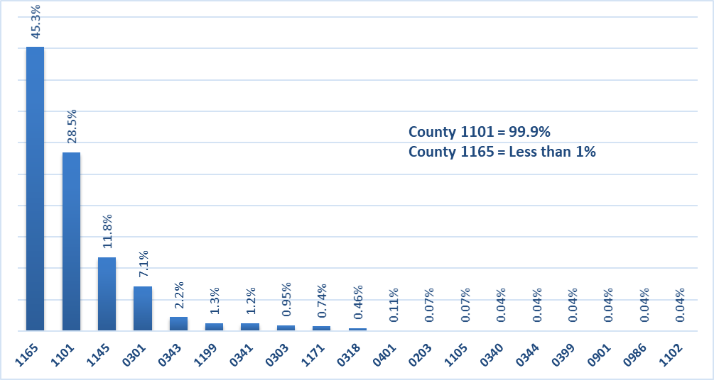
Current FSA Workforce by Series
www.jm-aq.com
Almost half of the Federal workforce falls in the 1165 series, with almost 60% who are Non-Supervisory Loan Specialists.
The County workforce consists of mostly employees within the 1101 series and the Non-Supervisory Program Tech positions encompass more than 75%.
Source: USDA – FSA Workforce Overview
Notes:
Simple Bullet Point Slide example

Slide 8
Onboard Strength within Series 1165 by Grade Groups in the last 5 fiscal years
www.jm-aq.com
Source: USDA – FSA Workforce Overview
Notes:
Simple Bullet Point Slide example

Slide 9
Current Hiring Activity – As of May 11, 2022
www.jm-aq.com
Source: USDA – FSA Workforce Overview
Notes:
Simple Bullet Point Slide example

Slide 10
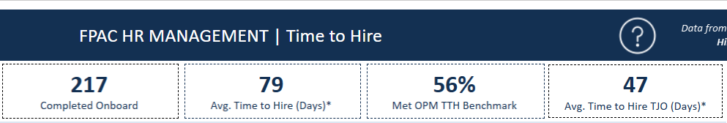
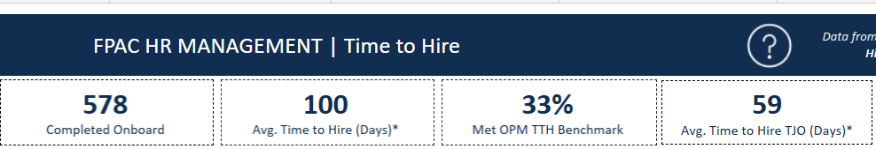
GS Time to Hire
www.jm-aq.com
FY 2022 approved hiring actions to date
FY 2021 approved hiring actions
Source: USDA – FSA Workforce Overview
Notes:
Simple Bullet Point Slide example

Slide 11
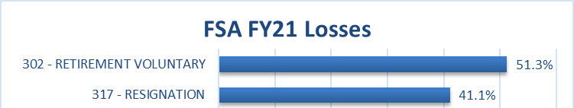
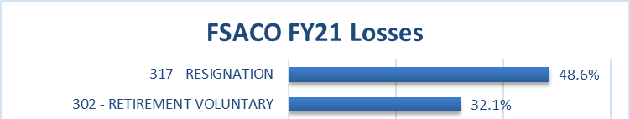
FSA Losses
www.jm-aq.com
The percent of FSA Federal losses in the 1165 series is 45%, reflective of the overall percentage of 1165 series in the current FSA workforce. A little more than half (56%) of the losses in the 1165 series since FY2017 have been due to retirement.
All losses in the County workforce have been in the 1101 series with about 84% of those who are Program Technicians.
Source: USDA – FSA Workforce Overview
Notes:
Simple Bullet Point Slide example

Slide 12
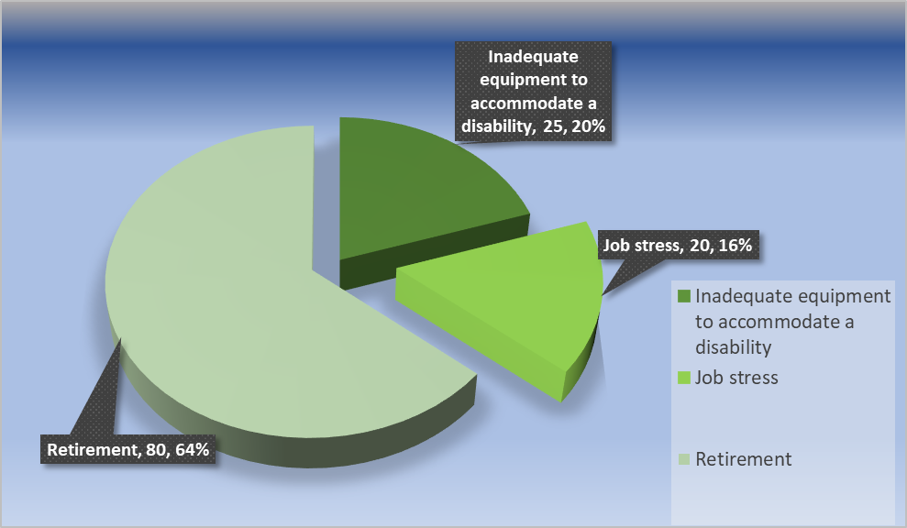
FSA Exit Interview Survey Results
www.jm-aq.com
Source: USDA – FSA Workforce Overview
Notes:
Simple Bullet Point Slide example

Slide 13
Outlook for 2022
www.jm-aq.com
Working with Congress on repealing direct loan term limits and FSA staffing and modernization, being proactive on allegations of civil rights complaints.
Gearing up for Farm Bill 2023.
Begin work on FSA pay parity with the private sector.
Notes:
Simple Bullet Point Slide example

Slide 14
Questions?
Notes:
Questions? Slide Draft

Slide 15
1030 15th Street, NW, Suite 590 West | Washington, DC 20005
(202) 296-2741 | www.jm-aq.com
Notes:
Ending Slide Draft

