Slide 1

Farm Production & Conservation Mission Area
FSA Workforce Overview

Slide 2
Executive Summary
All data provided are for permanent employees only and, unless otherwise specified.
FSA Federal and County Ceiling = 10,289
Double click the pdf below to see detailed information for onboard and FY22 losses.
Onboard Strength:
  At the end of FY2021
    FSA Federal = 2,988
    FSA County = 6,854
    1101 series = 856 Federal; 6,852 County
    1165 series = 1,368
  As of May 2022
    FSA Federal = 2,849
    FSA County = 6,712
    1101 series = 812 Federal; 6,710 County
    1165 series = 1,291

Slide 3
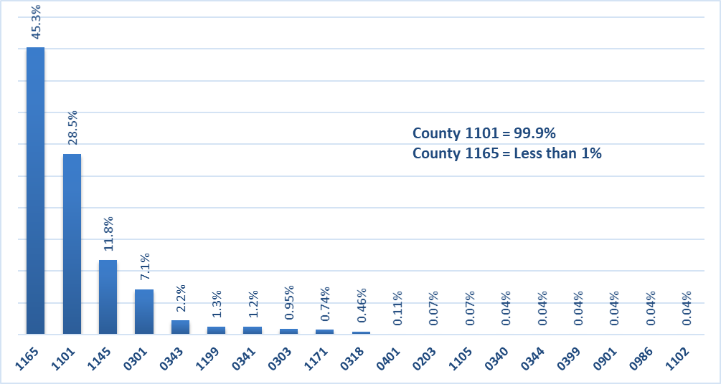
Current FSA Workforce by Series
Almost half (45.3%) of the Federal workforce falls in the 1165 series, with almost 60% who are Non-Supervisory Loan Specialists.
The County workforce consists of mostly employees within the 1101 series and the Non-Supervisory Program Tech positions encompasses more than 75%.

Slide 4
The Onboard Strength for the 1165 series has remained constant over the last 5 years.
Onboard Strength within Series 1165
by Grade Groups in the last 5 fiscal years

Slide 5
Current Hiring Activity
As of May 11, 2022

Slide 6
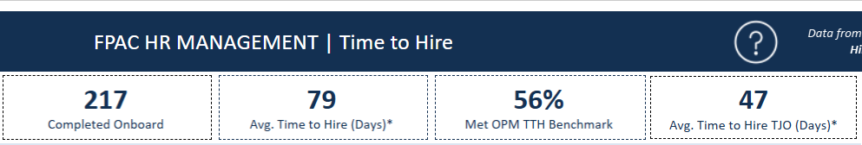
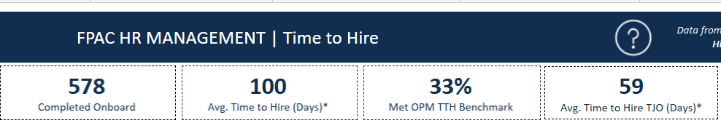
GS Time to Hire
FY 2022 approved hiring actions to date
FY 2021 approved hiring actions

Slide 7
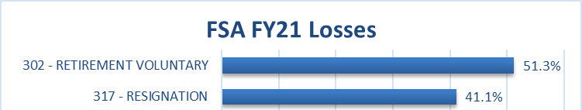
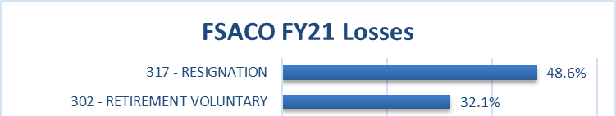
FSA Losses
The percent of FSA Federal losses in the 1165 series is 45%, reflective of the overall percentage of 1165 series in the current FSA workforce. A little more than half (56%) of the losses in the 1165 series since FY2017 have been due to retirement.
All losses in the County workforce have been in the 1101 series with about 84% of those who are Program Technicians.

Slide 8
Attrition by Series by Title
Comparing the average attrition, including retirements, the Federal Program Technician has seen the most loss with a little more than 12% between FY2018-FY2021. Loan Assistants and CO Program Technician positions also saw close to 12% average attrition.
All losses within the Loan Assistant and County Operations Trainee positions, were due to resignations and transfers, no retirements.

Slide 9
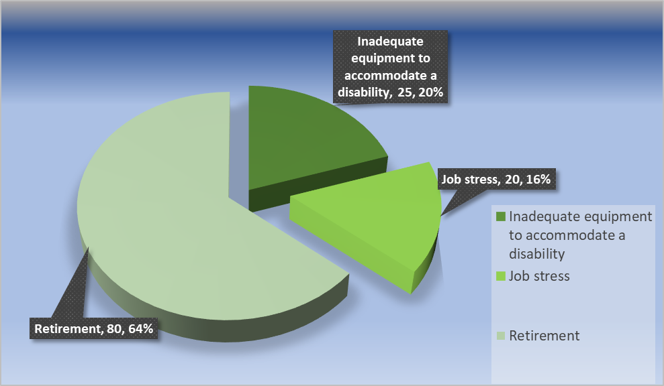
FSA Exit Interview Survey Results LEAVING AGENCY

Slide 10
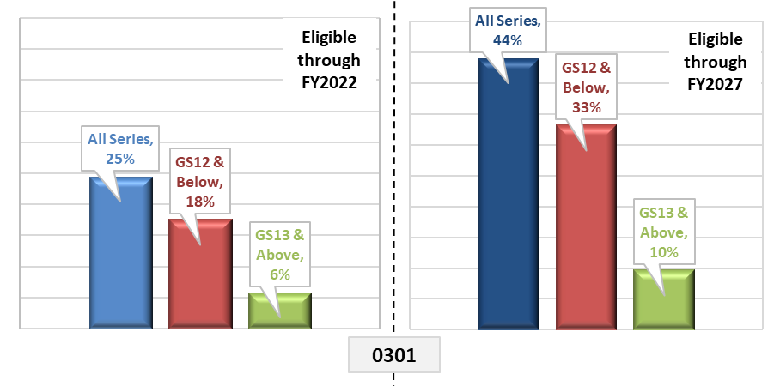
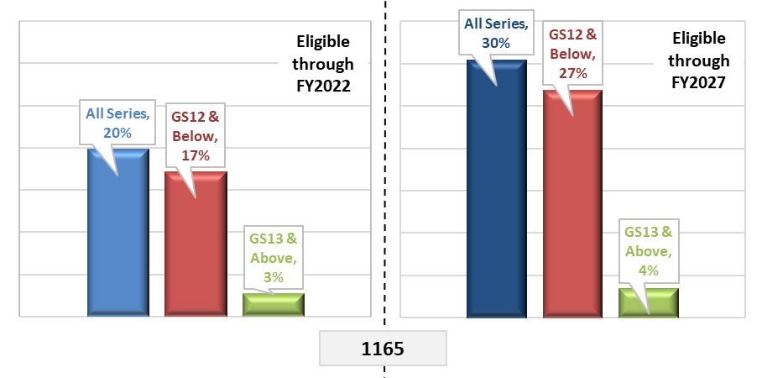
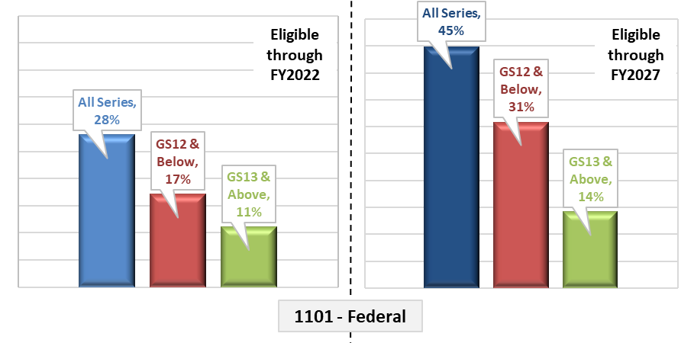
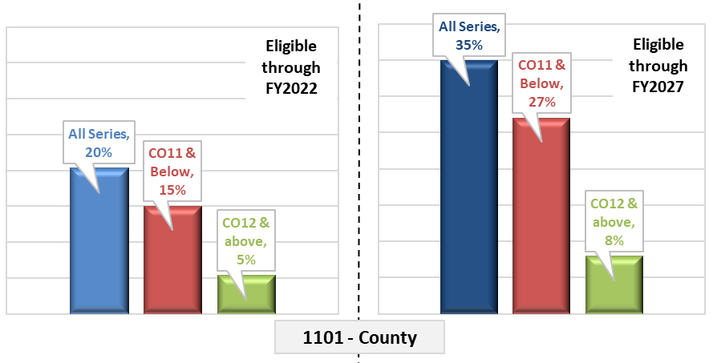
Retirement Eligibility by Grade

Slide 11
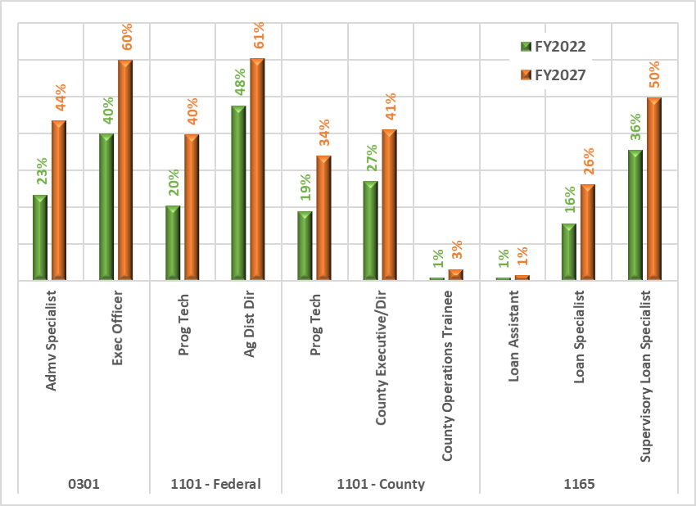
Retirement Eligibility by Title

Slide 12
Farm Loan Trainees (FLOT) and
County Executive Directors in Training (formerly COTs)
The data for FLOTs includes Federal employees in the 1165 series, grades 5 through 9, with titles including Loan Assistant (Agrl) and Loan Specialist (Agrl).
FLOTs and COTs currently represent about 21% of the 1165 workforce and about 2% of the 1101 workforce.
Notes:
Data captured before Covid, during Covid and current

Slide 13
FLOTs and COTs Retention
Within the External hires since October of 2018:
About 23% of FLOTs have separated with an average length of service of 1 year within the agency.
Almost 14% of COTs have separated with an average length of service of slightly less than 1 year within the agency.
The below charts represent the total External Hires, the total separations of those hires and the percent of loss for each fiscal year.
Notes:
Retention of FLOTs and COTs through the pandemic

