Slide 1
DAFLP Front Office Updates
2023 NACS/NASE National Convention
June 27, 2023 – Omaha, NE

Slide 2
BILL COBB
Deputy Administrator for Farm Loan Programs

Slide 3
TOPICS – Bill Cobb
1 | IRA Update
2 | Farm Bill Issues
3 | Loan Activity Review and FY 2024 ACIF Funding Update

Slide 4
Farm Loan Programs | Inflation Reduction Act
IRA work pending with RDSO:
Direct Borrowers 60 Days or More Delinquent – 343 (this includes those that are held up because of IT issues)
Disaster Set-Aside received during the pandemic period – 6
Direct Distressed Borrower Automatic Payments – 184
Finalizing the list of payments to be reversed from 60+-day delinquent loans that resulted from criminal judgments, as well as the list of additional payments to be issued on loans resulting from deficiency and other non-criminal judgments.
Guidance for reviewing bankruptcy borrowers for IRA eligibility was issued on June 22, 2023.
June 2023

Slide 5
Farm Loan Programs | Inflation Reduction Act
June 2023

Slide 6
Farm Loan Programs | Farm Bill
Providing technical assistance when requested.
Developed responses to technical assistance in advance.
Per June 23, 2023 Agri-Pulse:
“House Agriculture Committee Chairman Glenn “GT” Thompson, R-Pa., said draft language for the House bill could be available by August. Thompson was speaking at a Bloomberg Government event on Thursday.”
“Senate Agriculture Chairwoman Debbie Stabenow, who also spoke at the event along with the ranking members of the two committees, didn’t commit to a schedule for bill introduction. Stabenow, D-Mich., said she wouldn’t be surprised if Congress has to pass a brief extension of the 2018 bill.”
June 2023

Slide 7
Farm Loan Programs | Sources of Agricultural Credit
$441 billion in outstanding farm debt
3% provided through FLP direct loans
4% provided through FLP guaranteed loans
44% provided through the Farm Credit System – largest lender for farm real estate
36% provided through commercial lenders – largest lender for farm production loans
10% individuals and others
4% Life Insurance Companies
Source: Agricultural Credit: Institutions and Issues, Jim Monke – Congressional Research Service, July 27, 2022 - https://crsreports.congress.gov/product/pdf/R/R46768
June 2023

Slide 8
Farm Loan Programs | Historical Data
June 2023

Slide 9
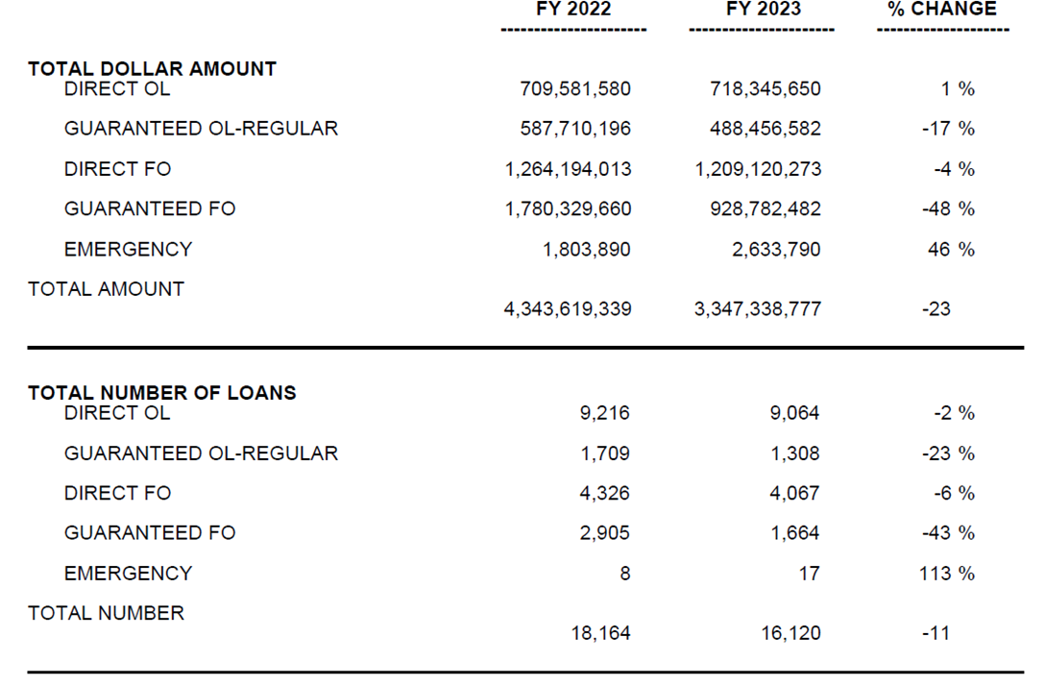
Farm Loan Programs | Loan Obligations – As of May 31
June 2023

Slide 10
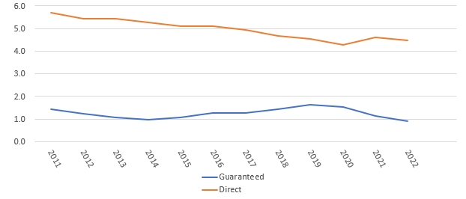
Farm Loan Programs | Delinquency Rates
June 2023

Slide 11
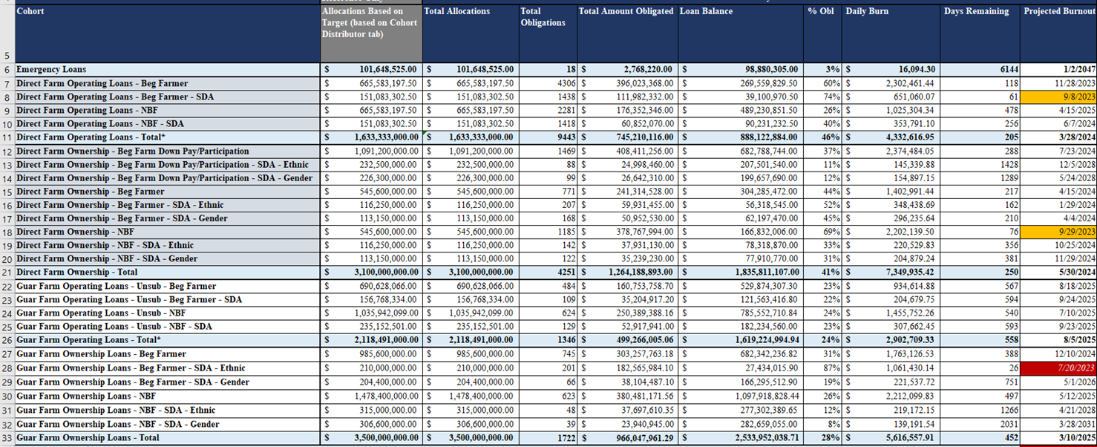
Farm Loan Programs | Farm Loan Program Budget – FY2024
FY 2024 proposed President’s Budget:
Similar to FY 2023 loan levels
Includes a slight increase in Salary and Expenses
June 2023

Slide 12
Farm Loan Programs | Farm Loan Program Budget (Continued)
For fiscal year 2023, unobligated 2022 budget authority for emergency loans carried over.
For FY 2023, $73M (<$6M remaining) in prior year budget authority was rescinded. ($90M rescinded in FY 2022)
Fiscal Year 2023 appropriation language includes authority to increase program levels for direct and guaranteed FO by no more than 25 percent, if needed. (Negative subsidy)
Secretary has interchange authority for loan programs with positive subsidy rates/budget authority – 7% of lower fund.
June 2023

Slide 13
Farm Loan Programs | Farm Loan Program Budget (Continued)
FSA Explanatory notes are available at: https://www.usda.gov/sites/default/files/documents/27-2024-FSA.pdf
Includes the following legislative proposals:
Elimination of Direct Farm Ownership and Operating Loan limits
Improvements to the Emergency Loan program to reduce application and eligibility requirements
Reducing Direct Farm Ownership experience eligibility requirements
Increasing the Direct Down Payment Loan Program limit
Doubling the Microloan limit
Opening access to Beginning Farmer benefits to entities comprised of non-related individuals
Expanding mediation services to Territories and Tribes
Revising Beginning Farmer Funding targets to improve timeliness of loan closings
June 2023

Slide 14
DANA RICHEY
Assistant Deputy Administrator for Farm Loan Programs

Slide 15
TOPICS – Dana Richey
1 | DAFLP Strategic Priorities
2 | IT Modernization
3 | Operational Review and Security Inspection Streamlining Process

Slide 17
Modernizing FLP’s Mission Delivery
Farm Loan Programs’ Modernization is Critical to Achieving its Strategic Priorities & Enabling Investments in Family Farms and Local Economies
FLP’s 6 Strategic Priorities: FLP’s six strategic priorities represent a focus on the future by building on existing capabilities to strengthen the quality and reach of loan services in midst of rapidly evolving realities for all stakeholders within the sector. Activities supporting these areas must work in concert with one another, acknowledging the interdependence of these priorities to achieve holistic and sustained outcomes.
Future Vision
Optimize resource capacity and time savings for employees, producers, and lenders.
Streamline, automate, and digitize end-to-end business processes with integrated workflows for enhanced and equitable customer experiences that adapt to changing customer needs and expectations.
Enable loan lifecycle processing that improves frontline and back office operating efficiencies, utilizes user-friendly IT solutions that truly address consumers’ loan making and servicing needs.
FY19-FY26 Transformation Timeline – What’s Been Accomplished
Milestone/Description
2019-2020 Transformation Planning: Planning for FLP strategic initiatives and modernization efforts begin in response to key challenges, including manual processes, archaic and siloed systems , resource constraints, disparate and inaccessible data, and a need for proactive data analysis. 2020-2023+ Robotic Process Engineering: By identifying and designing process automations, the Penny, Jerry and Joy Bots have reduced time-intensive manual tasks and paperwork, giving valuable time back to field staff to focus more on customers and analytical tasks. 2020-2023+ Big Data Analytics to Inform Policy Decisions: Efforts to access and analyze big data to target opportunities for internal process improvements and policies that will help customers to be more successful. Foundational work has led to 1) Application FastTrack 2) Accessible aggregate data for loan portfolio and borrower performance trend analysis 3) Deep dives into understanding the persona of distressed borrowers to target technical assistance. 2021-2022 Modernization Roadmap Complete: Identifying business process improvements to inform options for possible platforms, systems and applications, which will be used to develop an implementation blueprint. 2022-2023 Modernization Implementation Begins: Priorities are to implement customer-facing online Direct Loan application and online 24/7 Direct Loan repayment features, launching in 2023..
Robotic Process Automation Measurable Impact
June 2020 – March 2023
3 bots have given back 56,000+ hours annually to field staff for value-added activities As of March 31, 2023, Penny, Jerry, and Joy bots have pre-filled over 150,000 forms sent to customers Bots are reducing key stroke errors and standardizing processes
Farm Service Agency | Farm Loan Programs | May 2023
1

Slide 18
MAY 2023 Internal USDA Distribution Only
Modernizing FLP’s Mission Delivery
Farm Loan Programs’ Modernization is Critical to Achieving its Strategic Priorities & Enabling Investments in Family Farms and Local Economies
FY2022 – FY2026 Timeline
2019-2020
Transformation Planning – Completed
Planning for FLP strategic initiatives and modernization efforts in response to key challenges.
2020 & Ongoing
Robotic Process Automation – Launched
Development and Implementation of Penny Jerry, and Joy to pre-fill forms and reduce employee manual data entry
2022
IT Modernization Roadmap – Completed
Completed development of a 5-year plan that incorporates business priorities, technical dependencies, and analysis-driven timeline estimations.
Anticipated Outcomes
Loan Assistance Tool – Launched October 2022
Launched in October 2022, future enhancements are planned over the next three years.
Enable producers to make a payment online for any amount, at any time, and from anywhere
2023
Streamlined Application – Published January 2023
The simplified Direct Loan Application, FSA 2001, was launched in January 2023
Application Fast Track – Launching Summer 2023
Implementation of a process in summer 2023 to identify low-risk applicants to help accelerate their underwriting procedure.
Make online applications for new direct loans as efficient and intuitive as possible for farmers and ranchers
Online Direct Loan Applications – Launching Fall 2023
Testing begins summer 2023 with a nationwide launch in fall 2023
Reduction in redundant data-entry and loss of labor hours in the field
Online Direct Loan Repayment – Launching Fall 2023
Development of 24/7 customer payment portal for nationwide launch in fall 2023
PLAS Assessment – Due August 2023
GSA developing recommendations on how FSA and RD should continue to share a future modernized system, use separate solutions, or some combination
Increased efficiency in business processes and agility in responding to changing policy, operations, and legislation
Reduce Underwriting Data Entry – Analysis Beginning
Working to develop an API solution to link online direct loan application customer data entry to Farm Business Plan, eliminating employee manual data entry
Platform for End-to-End Loan Processes – To Be Started
Choose a COTS solution to provide automated, integrated business processes and data for customers and employees, followed by creating an implementation blueprint
2024 -2026
PLAS Replacement Implementation – To Be Started
Modernize the 50-year-old legacy loan accounting system, in partnership with RD
Employee, Applicant/Borrower CX Priorities
Develop a resilient infrastructure for future preparedness in the event of policy, operational and legislative changes.
Streamline, automate, and digitize end-to-end business processes for enhanced and equitable customer experiences which adapt to changing customer needs and expectations.
Improve customer satisfaction and measure outcomes of modernization efforts by surveying customers and non-customers quarterly to measure their experience with FLP employees, communication, processes, and technology.
Farm Service Agency | Farm Loan Programs | May 2023
2

Slide 19
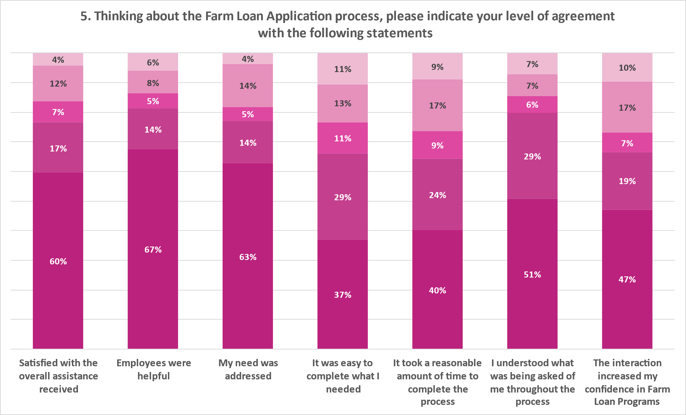
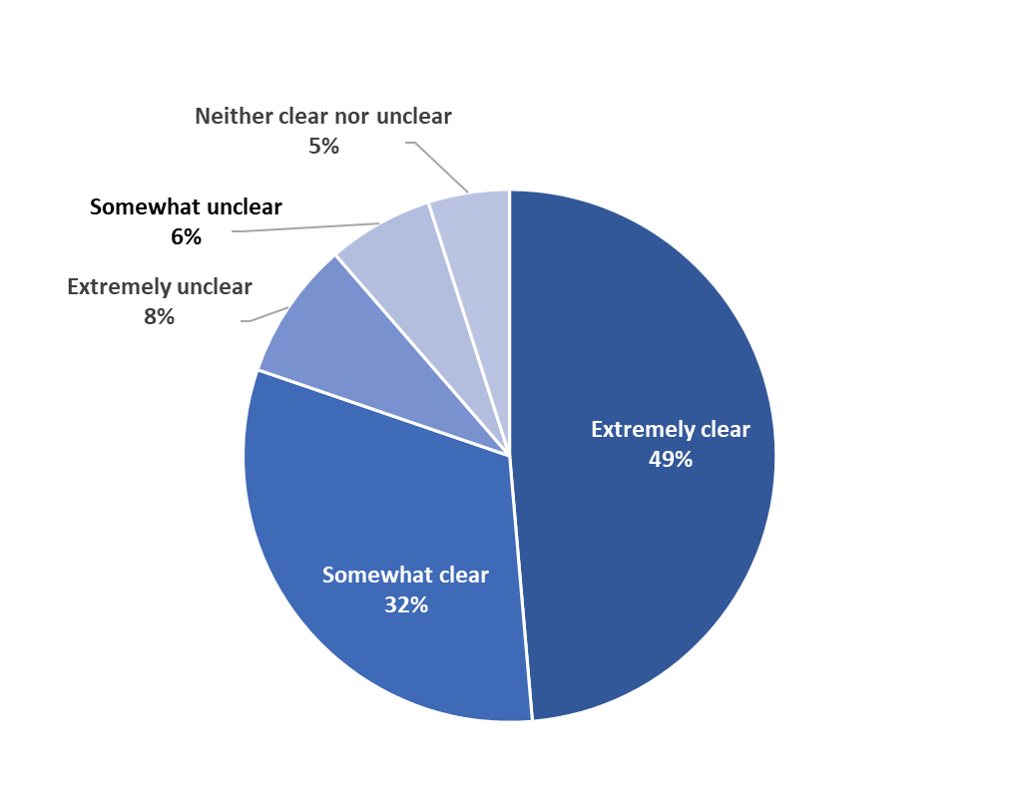
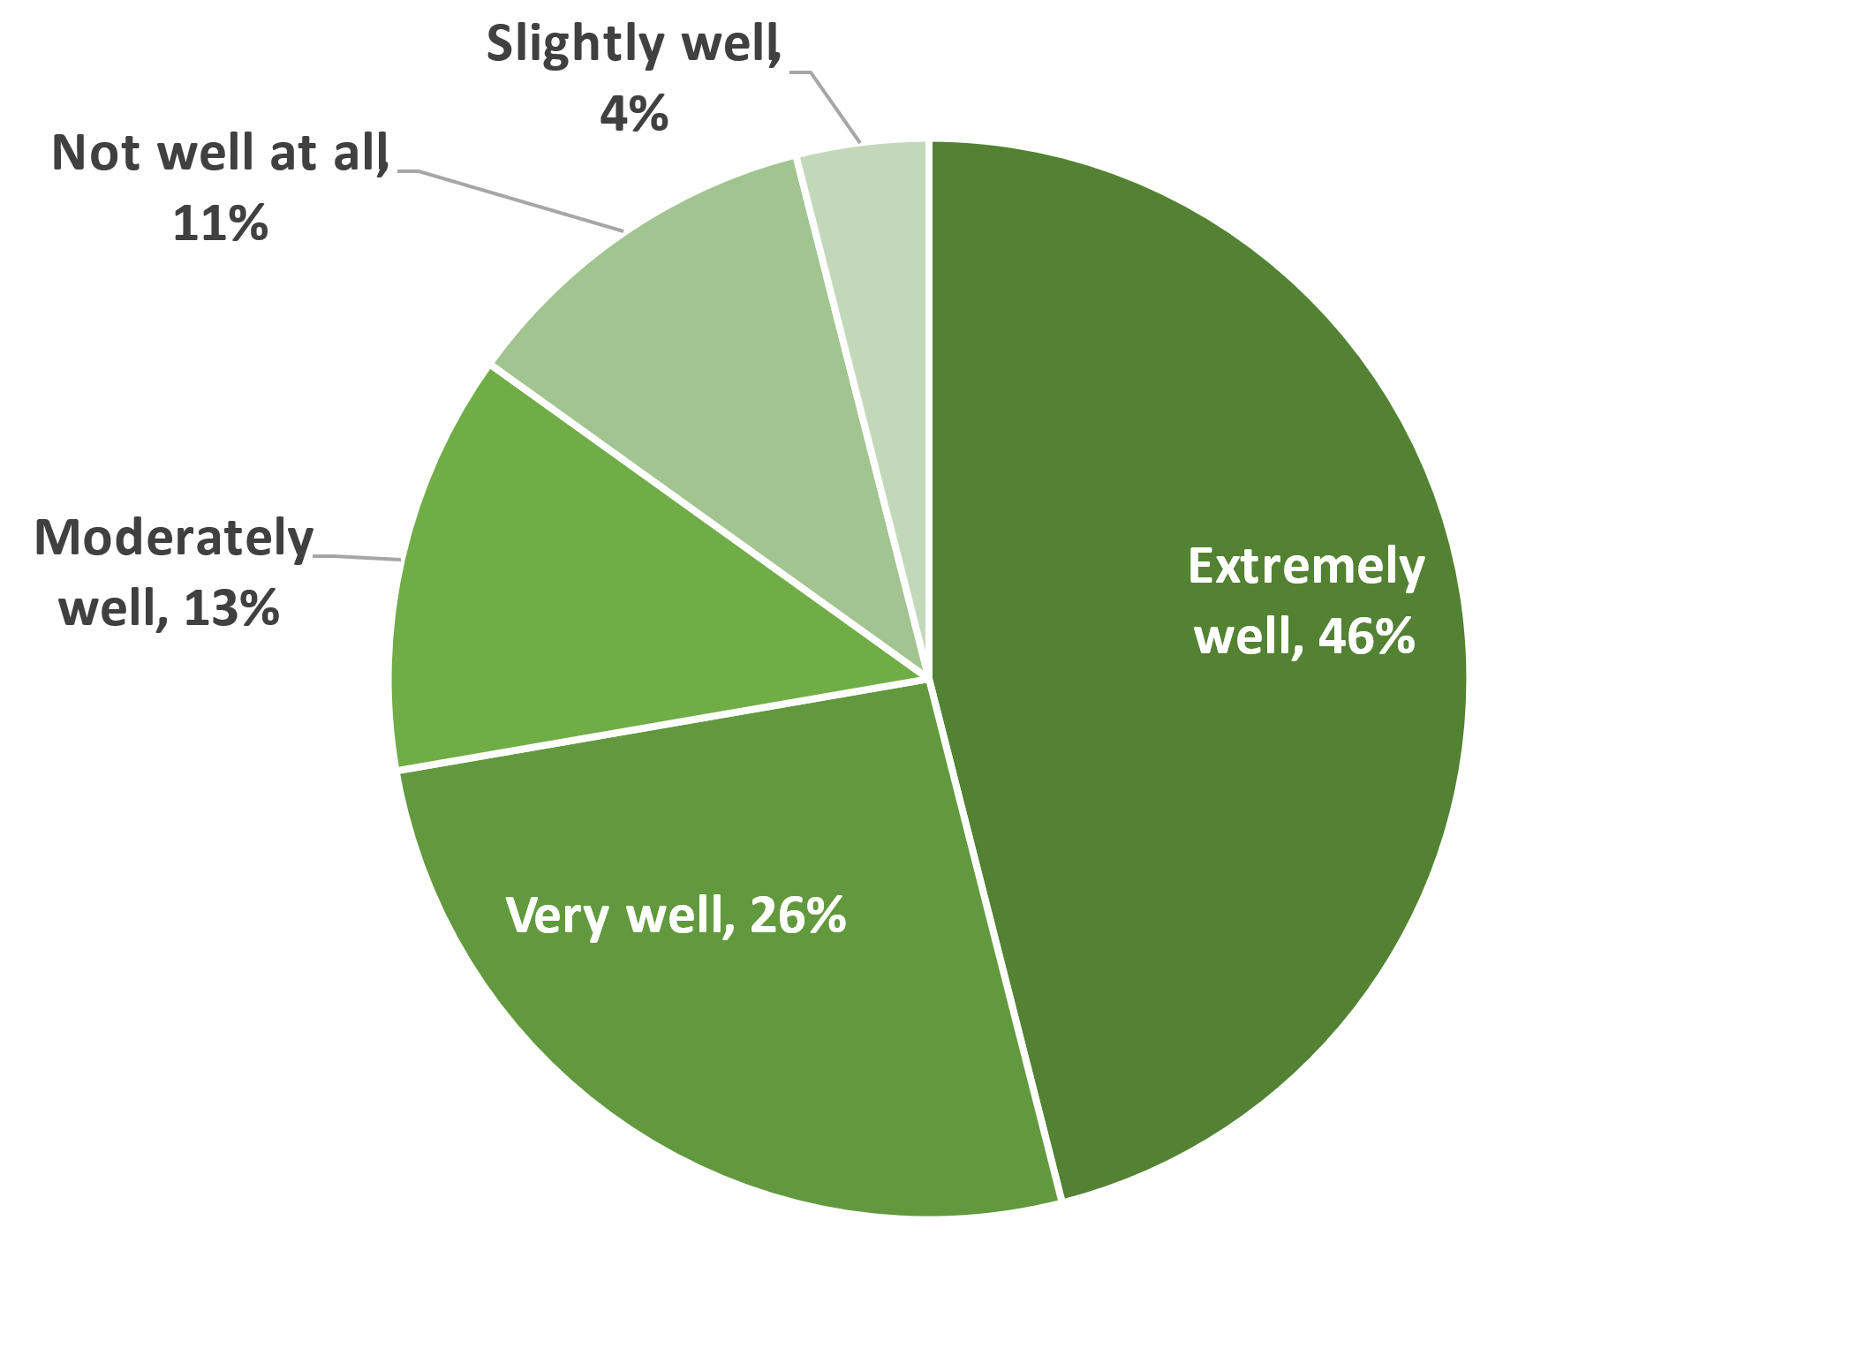
Modernizing FLP’s Mission Delivery
Farm Loan Programs’ Modernization is Critical to Achieving its Strategic Priorities & Enabling Investments in Family Farms and Local Economies
Customer Experience (CX)
FLP has been designated a Federal high impact service provider (HISP) program. We’re working towards FLP’s vision of a modernized customer experience using best practices recommendations from OMB and USDA CX Offices.
The first 2 CX Surveys were each sent to 1,250 Direct Loan applicants in November 2022 and March 2023. To establish baseline trends, there will be no changes in the first 3 CX Survey.
With the ongoing implementation of modernized solutions, customer surveys with direct feedback allow us to measure the impact of these solutions as outcomes rather than outputs.
Customer Feedback Survey Results
Neither Agree Nor Disagree
Strongly Disagree
Somewhat Disagree
Somewhat Agree
Strongly Agree
4. How clear was the information you received about the steps you need to take to complete your loan application?
7. How well was your loan determination explained to you in a way that you could understand?
Neither clear nor unclear
5%
Somewhat unclear
6%
Extremely Unclear
8%
Supporting FLP Modernization
Farm Service Agency | Farm Loan Programs | May 2023
3

Slide 20
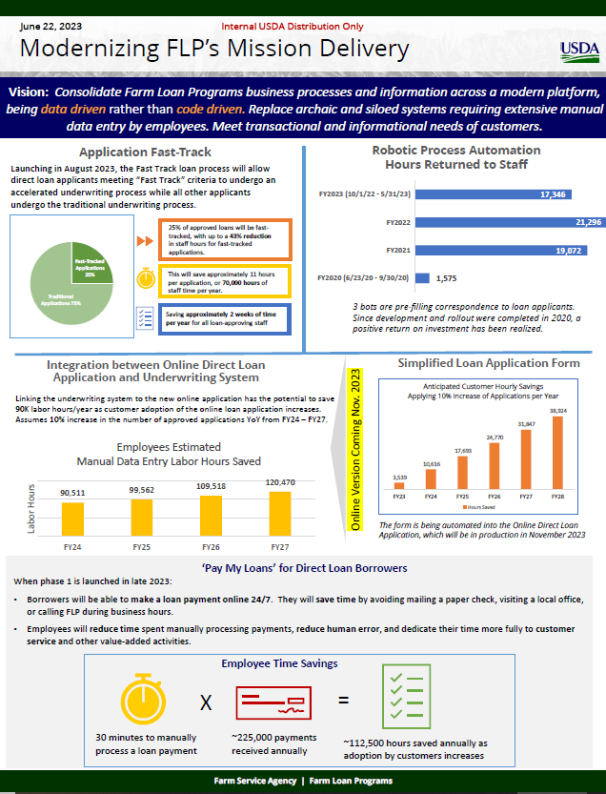

Slide 21
HOUSTON BRUCK
Assistant to Deputy Administrator for Farm Loan Programs

Slide 22
TOPICS – Houston Bruck
1 | Application Fast Track (AFT) Update
2 | Upcoming Regulatory Items

Slide 23
Farm Loan Programs | Application Fast Track Loan Underwriting Initiative
Objective: Identify a model that uses financial data to identify the 25% of applicants least likely to default¹ to undergo an accelerated underwriting process. This will result in:
Reductions in processing times
for all applicants
Staff time savings from accelerated underwriting
Redistribution of staff time and resources
Fast-tracked loans may be processed up to 25% —or around one week—faster. Other applicants could also experience faster processing times.
FLP staff could save up to 70,000 hours per year on fast-tracked applications, or ~2 weeks per loan official.
Additional staff capacity and flexibility could be dedicated towards applicants most in need of technical assistance.
The FSA Farm Loan Programs Deputy Area and the FPAC Economic and Policy Analysis Division developed a custom model to estimate the probability of default, which:
FLP will pilot the Application Fast Track process in Summer 2023 under existing pilot authority.
Pilot Scope
The pilot will collect data and allow for an assessment of:
Loan Outcomes
Time Savings
Customer and Staff Experience
Process Performance
Results will determine next steps for model refinement and/or Application Fast Track expansion.
Was developed with data from 100,000+ historic FLP loans.
Considers an applicant’s financial position and their repayment history with FSA and other creditors.
Fast-tracks ~25% of applicants with 94%+ accuracy of predicting default.
Effectively assesses risk, with identified fast-tracked loans having a default rate that is half the portfolio average.
Sites: 166 offices initially, with expansion anticipated in January 2024
Duration: 12+ months to complete and analyze a full loan cycle
Loan Types: All loan types in pilot offices, excluding Emergency and Youth loans
Applicants: Both new and subsequent loan applicants
The model assesses applicant repayment capacity using financial benchmarking, thereby reducing reliance on cash flow projections.
Eligibility
No Change
Feasibility
Security
No Change
June 2023
¹ Default outcomes consider if a loan defaulted at any time since origination. Loan may have been brought current and does not necessarily reflect a financial loss to FSA.

Slide 24
Underwriting Process Flow: AFT
The Fast Track loan process will allow applicants meeting Fast Track criteria to undergo an accelerated underwriting process while all other applicants undergo traditional underwriting.
Application Fast Track
Borrower Submits Data
Input abbreviated data into FBP
Complete AFT Evaluation
Abbreviated Farm Assessment
Abbreviated Credit Presentation
Loan Approval
Traditional Underwriting
Enter actual and projected financials
Farm Assessment
Credit Presentation
Loan Approval

Slide 25
AFT Customer Experience
Under the Application Fast Track process, we anticipate that customers will experience expedited processing times while still collaborating closely with the loan official.
Applicants submit the same information as part of their application.
Applicants may be required to provide less information to the loan officer to validate financials.
If successfully fast-tracked and approved, customers receive earlier notification.
Customers are informed of and can opt-out of their Fast Track decision for any reason.
For customers that are fast-tracked, processing times are estimated to improve by at least 1 week per applicant.

Slide 26
Farm Loan Programs | Application Fast Track Loan Underwriting Initiative
Loan officials will be able to process fast-tracked applications more quickly by bypassing the entry and analysis of actual and projected cashflow information. This results in time savings for all applicants through fast-tracking or overall efficiency gains.
Loan Applicant
Potential Time Savings:
~1 week under Application Fast Track (25% reduction)
Loan Official
Potential Time Savings:
~11 hours per Application Fast Track application (43% reduction)
The loan application process remains the same from a customer perspective.
Loan official spends less time entering and validating cash flow budgets, expediting actual and projected budget analysis.
Applicants submit standard application materials, keeping the process consistent with traditional underwriting.
Loan official calculates Application Fast Track score using electronic tool
To ensure equitable treatment of applicants, loan officials will not be able to remove a loan from Application Fast Track consideration.
Fast-tracked applicants will not be required to validate cash flow data, which could result in time savings.
If the loan qualifies for Application Fast Track, the loan official completes an abbreviated farm assessment and credit presentation.
If successfully fast-tracked and approved, customers receive earlier notification.
Loan official reduces time spent in correspondence with the applicant, as less documentation is required.
Customers are informed of their Application Fast Track decision and can opt-out of the process for any reason (e.g., consideration for balloon installments or limited resource interest rates).
Loan official can easily transition to traditional underwriting if the loan does not qualify for Application Fast Track, as all standard information was already collected.
If not fast-tracked, customers revert to traditional underwriting and benefit from improved processing times and/or more time for technical assistance.
No applicant will ever be denied due to an Application Fast Track evaluation; they will instead be reverted to traditional underwriting review processes.
June 2023

Slide 27
Farm Loan Programs | Application Fast Track Loan Underwriting Initiative - Project Plan
2022 |  |  |  |  |  |  | 2023
Jun | Jul | Aug | Sep | Oct | Nov | Dec | Jan | Feb | Mar | Apr | May | Jun | Jul
Work initiated prior to June 2022.
Model Development and Testing
Finalize scorecard model
Develop and validate in-house scoring model
Validate Moody’s model with FLP data
Select scorecard model approach
Pilot Sample Selection and Assignment
Finalize pilot scope/approach
Identify pilot scope and approach (e.g., loan types, treatment and control groups)
Identify sample size and select pilot sites
Confirm site participation
Process Development
Identify and convene task force to develop process flow
Validate process flow with internal stakeholders
Document and validate procedures with internal stakeholders
Finalize procedures
Approval for final procedures
Federal Register Pilot Notice
Draft and review notice
Submission and OGC review
Technical Implementation (FBP)
Identify system changes required
Application Fast Track functionality go-live
Implement and test system functionality
Training & Communications
Develop overview and roll-out materials
Announce pilot to field
Draft training materials and schedule training sessions
Training Delivery
Pilot Launch
~Aug 7
Establish check-in cadence
Measurement
Ongoing efforts during the pilot will include:
Check-ins to collect feedback and answer questions
Periodic validation of data
Data analysis expected to occur at pilot mid-point (~5 mos.) and completion (15 mos.)
Define indicators, establish measurement process
Draft survey/focus group material and validate with stakeholders
Data checkpoints
Operation & Implementation
Monitor pilot sites and provide support
Work continues after July 2023
Key event or decision
June 2023

Slide 28
Upcoming Regulatory Items
DAFLP has been drafting a rule “Enhancing Program Access, Equity and Delivery for Farm Loans”
Federal Register publication is anticipated this year and will make a wide-range of changes
ELIGIBILITY
Family Farm Definition
Test for Credit
Production Training
FEASIBILITY
Loan Terms
Repayment Schedules
SECURITY
Additional Security
Collateral Releases

Slide 29
Thank You!

